Slide 1
CHAPTER 2
OVERFLOW
ROUNDING

Slide 2



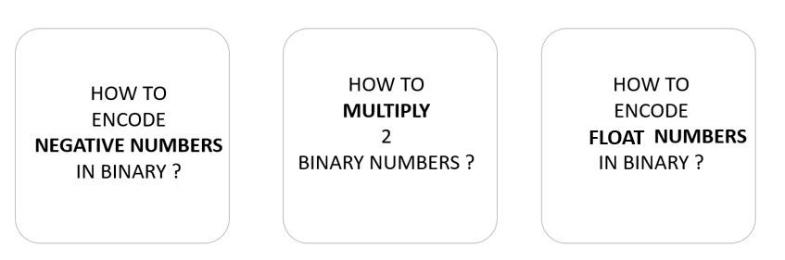
PRESENT
20 MIN
INDIV
CLASS
3 students present their search results regarding the topic they chose
5 min max per student

Slide 3

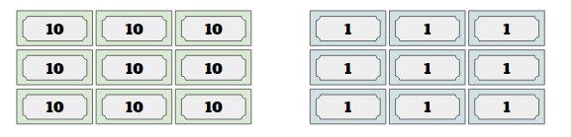
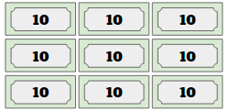
DISCUSS
You are a cashier in a grocery store
5 MIN
ALL CLASS
You have:
9 $100 bills
9 $10 bills
9 $1 bills
What’s the largest amount of change that you can give someone?
What’s the least?
What would you do if someone needed 2000 riels in change?
0
0
0
0
0
0
0
0
0

Slide 4
A system has limits
999 $
1 $
What’s the largest amount of change that you can give someone?
What’s the least?
What would you do if someone needed 2000 riels in change?
We cannot
0
0
0
0
0
0
0
0
0

Slide 5
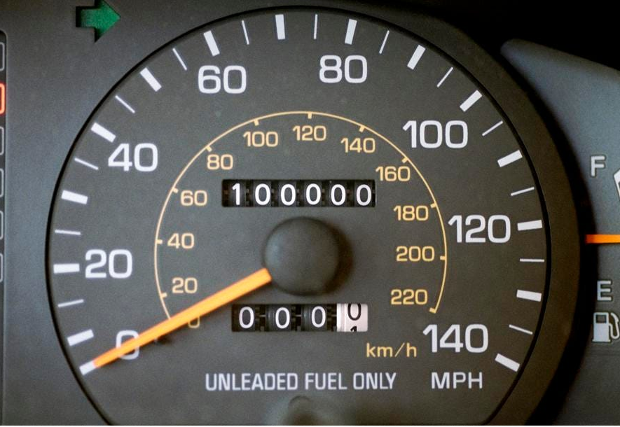
PRACTICE
Explore the odometer
10 MIN
INDIV
Go to the link
https://studio.code.org/s/odometer/next
Set the LARGEST number
Add 1 to the value
What happens ?
An odometer measures the distance travelled by a car

Slide 6

EXPLAIN
What is an overflow ?
CLASS
An overflow happens when the Number System get a number outside of its ability to handle
Overflow !
+1

Slide 7
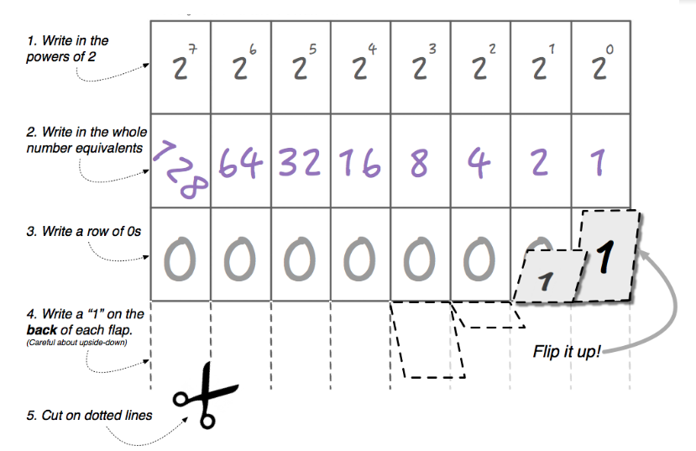
PRACTICE
Explore your Flippy
5MIN
TEAM 2
What is the max number you can make ?
What s happen if you want to represent (max +1) ?
What adaptation could you make to the Flippy Do to represent (max +1) ?
Your Flippy
Notes:
Discussion Goal: Use this conversation to show that we can always add bits to represent more numbers but when working with a set number of bits, at some point we will run into overflow if we try to represent large enough values.
Look for students to physically model overflow using the Flippy Do, going from when all of the 1s are flipped up to the next number causing all the 1s to reset to 0s.
With the Flippy Do, trying to represent the number 256 will cause an overflow. One common adaptation students will come up with is adding an additional column/bit to the Flippy Do to be able to represent that number. For a 9-bit Flippy Do, the first number that will cause overflow is 512.

Slide 8

PRACTICE
5MIN
TEAM 2
You manage a candy shop
Here are the prices of 4 of the candies you will be selling
Candy | Decimal Price | Binary Price
Gummy Bears | $1.76/lb
Chocolate | $4.16/lb
Licorice | $7.52/lb
Mints | $0.48/lb
????
You need to put a binary number into your shop’s computer system to represent the price for each candy
????
????
????
You system manage only 4 bits
Notes:
Many students may use traditional rounding to decide on the prices for each of the candies. Some may come up with a system where the shop pays the difference and others may come up with a system where the customer pays the difference. See the table below for how those values would be represented in binary.

Slide 9
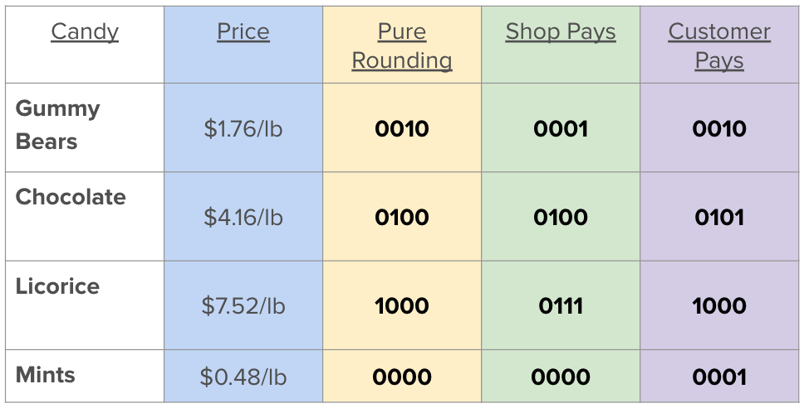
Different strategies to handle the lost value !

Slide 10
EXPLAIN
What is an rounding ?
CLASS
An rounding happens when the Number System is not accurate enough to represent a number
System values
Requested value

Slide 11
EXPLAIN
Converting a number
From a number system to another number system
Can cause
OVERFLOW
ROUNDING
The system is too small
The system is not accurate enough
= loose of information

Slide 12


HOMEWORK
Watch this video
https://www.youtube.com/watch?v=5tJPXYA0Nec
Understand the reason why ARIANE 5 crashed in the sky in 1996

